Slide 1
ITCS 3134
KWOK YIN HANG
E13 - Morphology 1

Slide 2
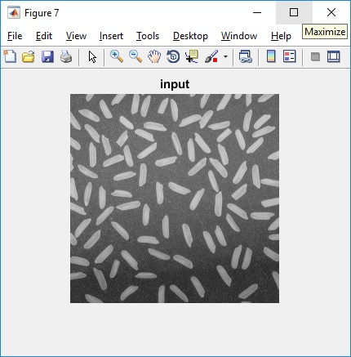
input image, f

Slide 3
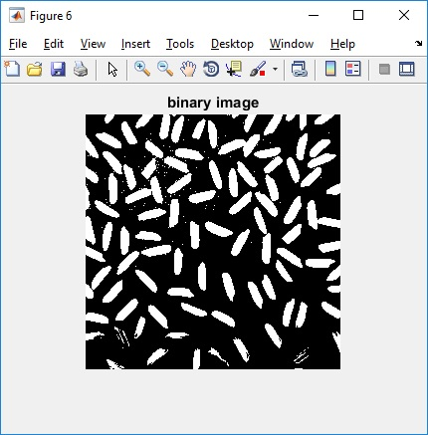
binary image, g

Slide 4
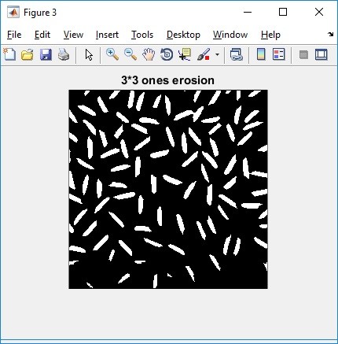
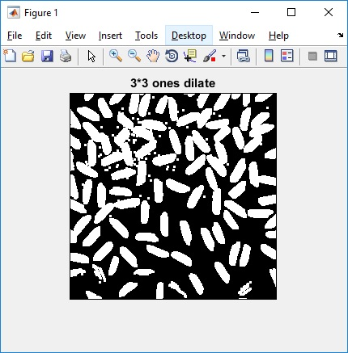
comparison of erosion and dilation. include both 3x3 results
3x3 comparison
Erosion make objects in image smaller than original size
Dilate make objects in image bigger than original size

Slide 5
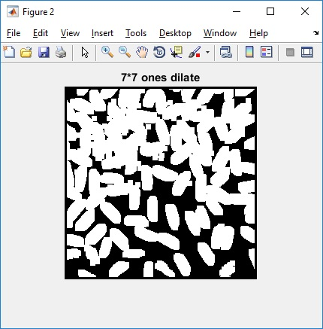
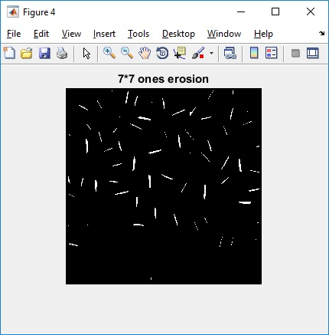
comparison of erosion and dilation. include both 7x7 results
7X7 comparison

Slide 6
comparison of different sizes. compare dilate with 3x3 and 7x7

Slide 7
comparison of different sizes. compare erosion with 3x3 and 7x7.

